Slide 1
7. Continuous Random Variables
ENGG 2760A / ESTR 2018: Probability for Engineers
Fall 2020

Slide 2

Delivery time
A package is to be delivered between noon and 1pm.
You go out between 12:30 and 12:45.
What is the probability you
missed the delivery?

Slide 3
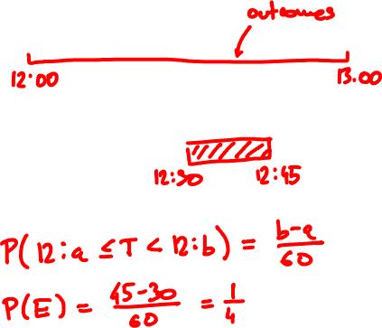
Delivery time
1. Sample space:
2. Event of interest:
3. Probabilities?

Slide 4
Uncountable sample spaces
In Lecture 1 we said:
“The probability of an event is the sum of the
probabilities of its elements”
…but all elements have probability zero!
To specify and calculate probabilites, we have to work with the axioms of probability

Slide 5
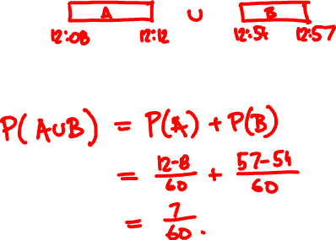
Delivery time
From 12:08 - 12:12 and 12:54 - 12:57 the doorbell wasn’t working.
Event of interest:
Probability:

Slide 6
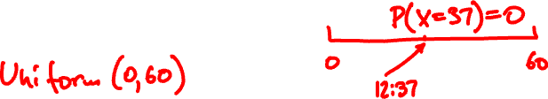
The uniform random variable
Sample space Ω = [0, 60)
Events of interest:
intervals [x, y) ⊆ [0, 60)
their intersections, unions, etc.
Probabilities:
P([x, y)) = (y – x)/60
Random variable:
X(ω) = ω

Slide 7

Cumulative distribution function
The probability mass function doesn’t make much sense because P(X = x) = 0 for all x.
Instead, we can describe X by its cumulative distribution function (CDF) F:
F_{X}(x) = P(X ≤ x)

Slide 8
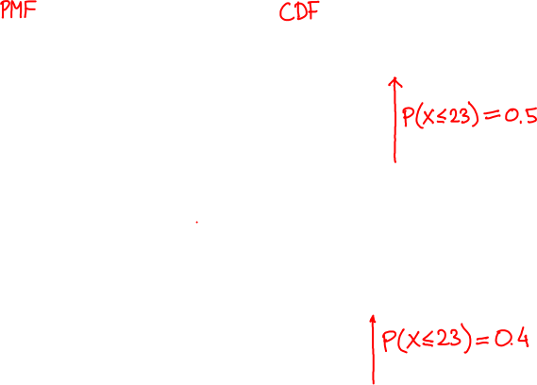
Cumulative distribution functions
f_{X}(x) = P(X = x)
F_{X}(x) = P(X ≤ x)

Slide 9
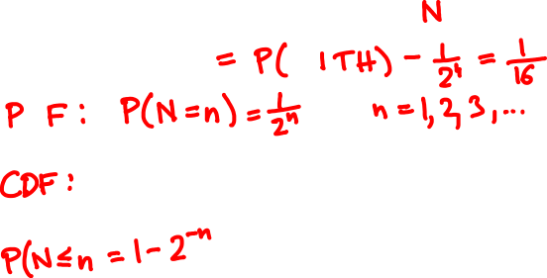
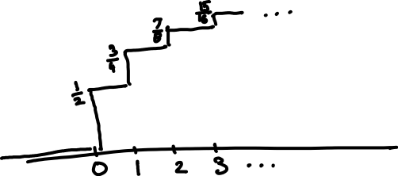

What is the Geometric(1/2) CDF?

Slide 10

Uniform random variable
If X is uniform over [0, 60) then
X ≤ x
0
x
60
F(x)
0
for x < 0
P(X ≤ x) =
x/60
for x ∈ [0, 60)
1
for x > 60
x

Slide 11
Cumulative distribution functions
discrete CDF F(x) = P(X ≤ x)
PMF f(x) = P(X = x)
?
continuous CDF F(x) = P(X ≤ x)

Slide 12

Discrete random variables:
PMF f(x) = P(X = x)
CDF F(x) = P(X ≤ x)
f(x) = F(x) – F(x – δ)
F(a) = ∑_{x ≤ a} f(x)
for small δ
Continuous random variables:
The probability density function (PDF) of a random variable with CDF F(x) is
F(x) – F(x – δ)
dF(x)
f(x) =
lim
=
δ
dx
δ → 0

Slide 13
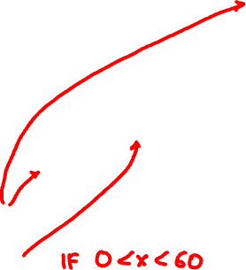
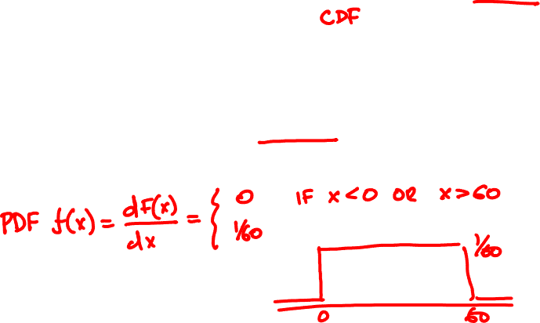
Uniform random variable
0
if x < 0
F(x) =
x/60
if x ∈ [0, 60)
1
if x ≥ 60

Slide 14
Probability density functions
discrete CDF F(x) = P(X ≤ x)
PMF f(x) = P(X = x)
continuous CDF F(x) = P(X ≤ x)
PDF f(x) = dF(x)/dx

Slide 15
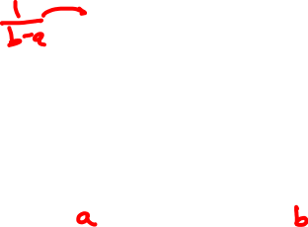
Uniform random variable
The Uniform(0, 1) PDF is
1
if x ∈ (0, 1)
f(x)
f(x) =
0
if x < 0 or x > 1
The Uniform(a, b) PDF is
1/(b - a)
if x ∈ (a, b)
f(x) =
0
if x < a or x > b
X
a
b

Slide 16

Calculating the CDF
Discrete random variables:
PMF f(x) = P(X = x)
CDF F(x) = P(X ≤ x) = ∑_{t ≤ x} f(t)
Continuous random variables:
PDF f(x) = dF(x)/dx
CDF F(x) = P(X ≤ x) = ∫_{t ≤ x} f(t)dt

Slide 17
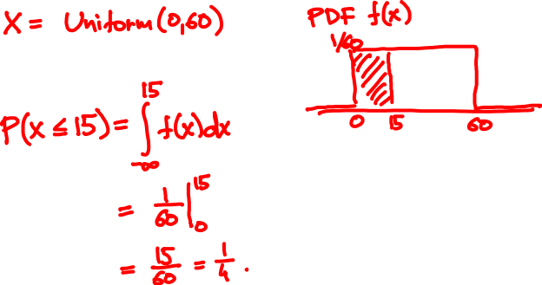
A package is to arrive between 12 and 1
What is the probability it arrived by 12.15?

Slide 18
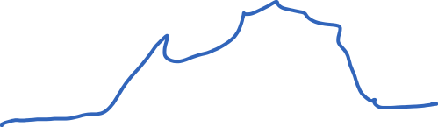
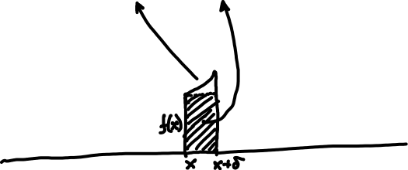
Interpretation of the PDF
The PDF value f(x) δ approximates the probability that X in an interval of length δ around x
P(x – δ ≤ X < x) = f(x) δ + o(δ)
P(x ≤ X < x + δ) = f(x) δ + o(δ)

Slide 19
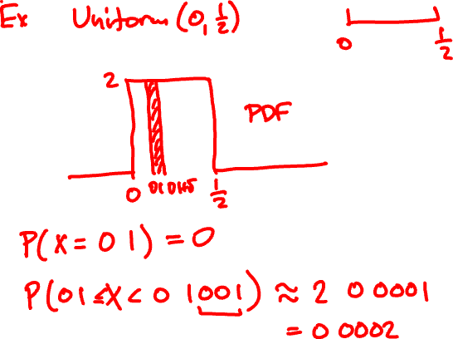

Slide 20



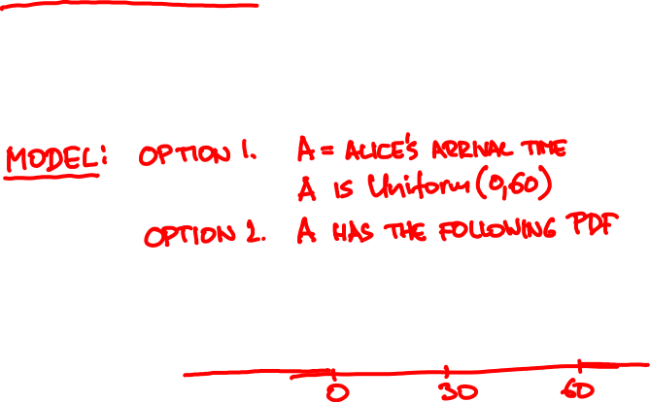
Alice said she’ll show up between 7 and 8,
probably around 7.30.
It is now 7.30. What is the probability
Bob has to wait past 7.45?

Slide 21
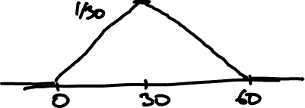
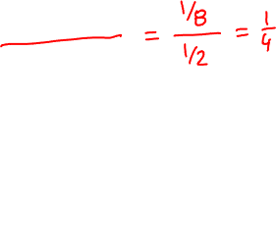
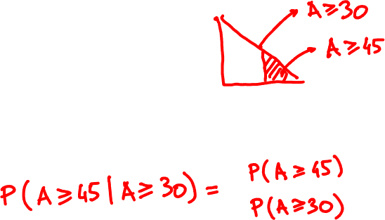

Slide 22
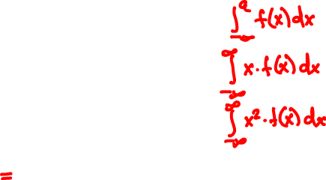

Expectation and variance
PMF f(x)
PDF f(x)
P(X ≤ a)
∑_{x ≤ a} f(x)
E[X]
∑_{x} x f(x)
E[X²]
∑_{x} x² f(x)
Var[X]

Slide 23
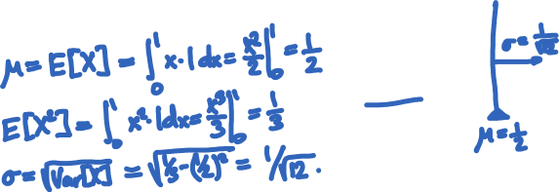

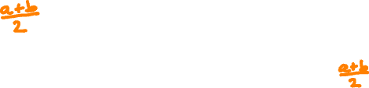
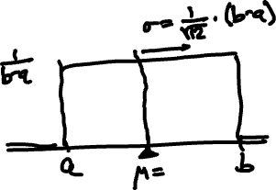
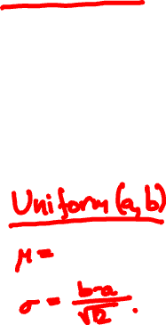
Mean and Variance of Uniform

Slide 24


Raindrops again
Rain is falling on your head at a rate of λ drops/sec.
1
2
How long do we wait until the next drop?

Slide 25
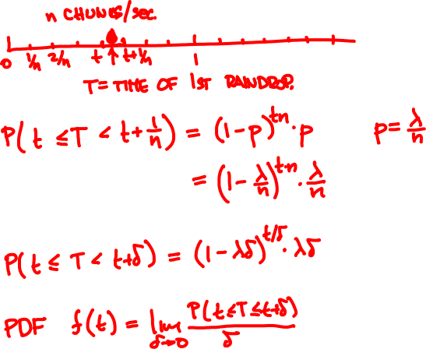



Slide 26
Geometric(3/10)
Geometric(3/100)
Geometric(3/50)
Exponential(3)

Slide 27

The exponential random variable
The Exponential(λ) PDF is
λ e^{-λt}
if x ≥ 0
f(t) =
0
if x < 0.
λ = 1
λ = 1
PDF f(t)
CDF F(t) = P(T ≤ t)

Slide 28

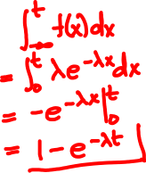
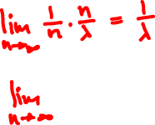

The exponential random variable
CDF of Exponential(λ):
E[Exponential(λ)] =
Var[Exponential(λ)] =

Slide 29
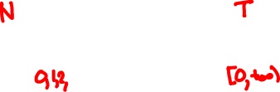
Poisson vs. exponential
N
1
2
T
Poisson(λ)
Exponential(λ)
description
number of events within time unit
time until first event happens
expectation
λ
1/λ
std. deviation
λ
1/λ

Slide 30
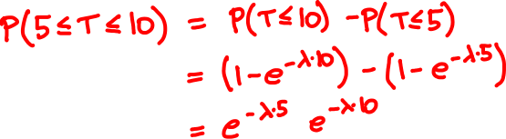
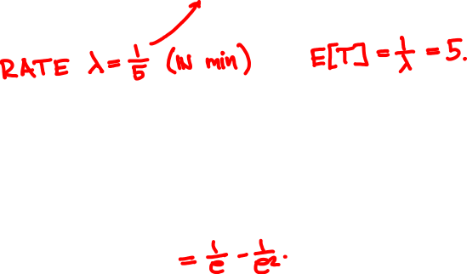

A bus arrives once every 5 minutes. How likely are you to wait 5 to 10 minutes?

Slide 31
Binomial(64, 1/2)
Binomial(1000, 1/2)
Binomial(100, 1/2)
Normal(0, 1)

Slide 32

The Normal(0, 1) random variable
PDF
CDF
f(x) = (2π)^{-½} e^{-x /2}
F(x) = (2π)^{-½} ∫_{t ≤ x} e^{-t /2} dt
²
²
E[Normal(0, 1)] =
Var[Normal(0, 1)] =

Slide 33


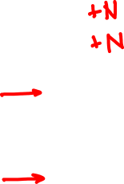

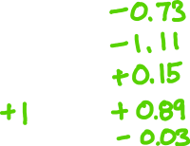
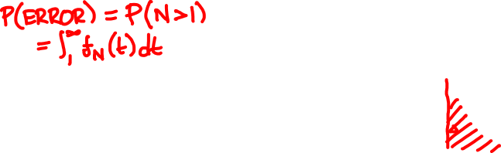
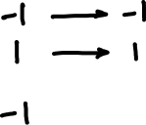
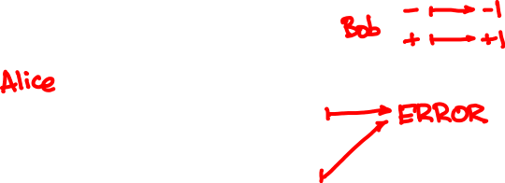
https://stattrek.com/online-calculator/normal.aspx

Slide 34
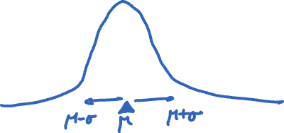

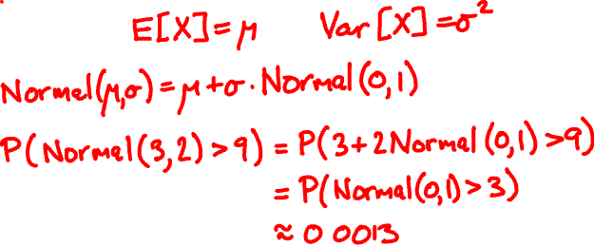
The Normal(μ, σ) random variable
f(x) = (2πσ²)^{–½} e^{– (x – μ) /2σ}
²
²

